Slide 1


Insurance Data Analytics

Slide 2
Challenges:
Difficulty in identifying high-risk customers
Increasing cases of fraudulent claims
Lack of visibility into policy performance
Delayed insights Inefficient analysis of customer behaviour and trends
due to traditional batch processing systems
Analytical Platform to Address the challenges:
Integrates multiple datasets (customers, policies, claims, payments)
Processes both batch and real-time data
Performs data cleaning, transformation, and aggregation
Generates meaningful insights using Amazon Lambda and Glue functions.
Visualizes results using Amazon Quick Sight dashboards.
Business Use Case
This project simulates a real-world insurance analytics system designed to help insurance companies make data-driven decisions using big data technologies.
In the modern insurance industry, companies deal with large volumes of structured and semi-structured data coming from multiple sources such as customer records, policy details, claims transactions, and payment histories. Managing and analysing this data efficiently is critical for improving business performance and reducing risks.

Slide 3

Real-Time Analytics
1 Real-Time Decisions
Enable immediate insights on how the insurance business is performing, where money comes from, and where it is lost.
2 Fraud Detection
Identify suspicious claims patterns instantly to reduce financial losses.
3 Risk Management
Analyze behavioral signals to assess and mitigate portfolio risks dynamically.

Slide 4




Project Objectives
Data Cleaning & Transformation
Standardize raw CSV data and apply transformation rules for quality.
Incremental Processing
Process only new or changed records using Kinesis streaming.
Fraud Detection
Apply logic to flag suspicious claims and high-risk patterns.
Amazon Quick Sight Visualization
Visualize insights via interactive dashboards for business users.

Slide 5
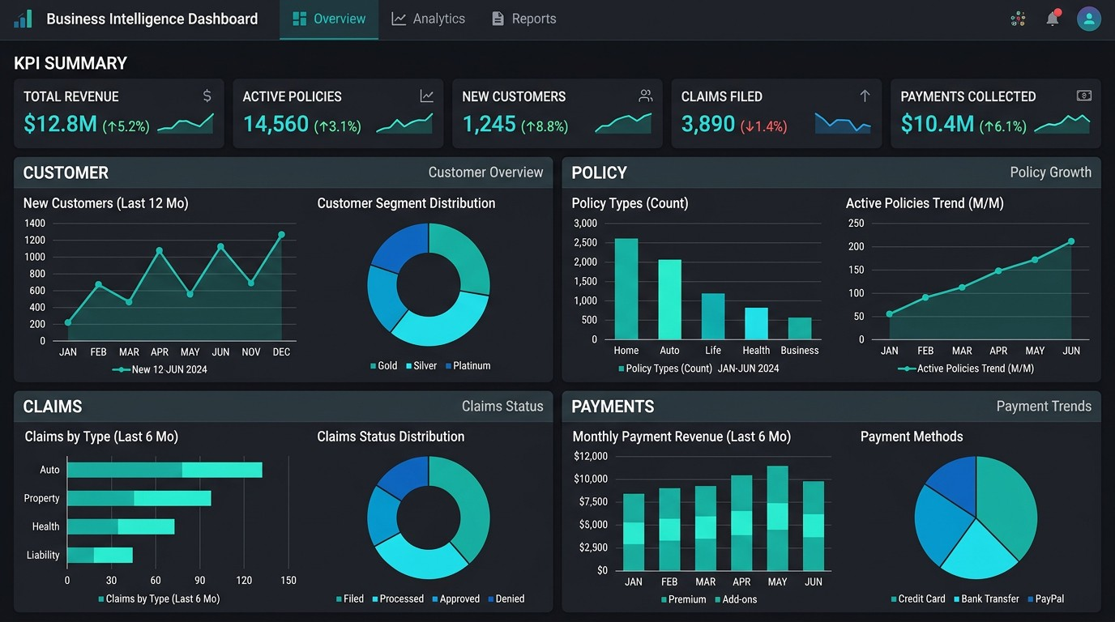
Project Outcome
📌 Customers
Who are my top customers?
Which region brings most revenue?
📌 Policies
Which policy type performs best?
Are policies growing or declining?
📌 Claims
Which policies generate most claims?
Are claims increasing over time?
📌 Financials
Are we profitable?
Where are we losing money?

Slide 6
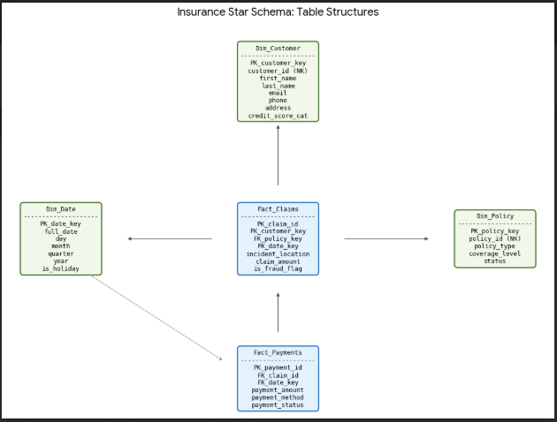
Data Model
Star Schema is used to
Faster Query Performance
Optimized for Analytics (OLAP)
Reusable Dimensions (Conformed Dimensions)

Slide 7

Execution Process
1. Data Ingestion — Load raw CSVs / events
2. Data Cleaning — Handle nulls & formats
3. Data Transformation — Apply logic
4. Integration — Join datasets
5. Streaming — Data load using API
6. Gold Insights — Ready for BI

Slide 8
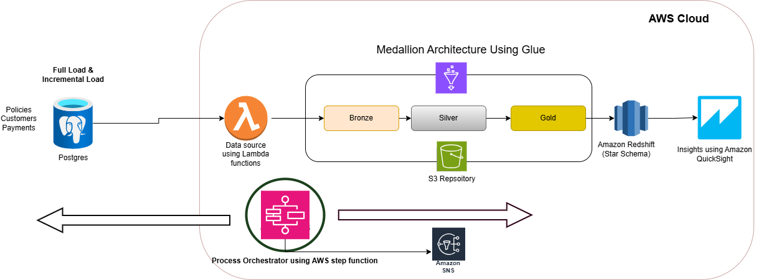

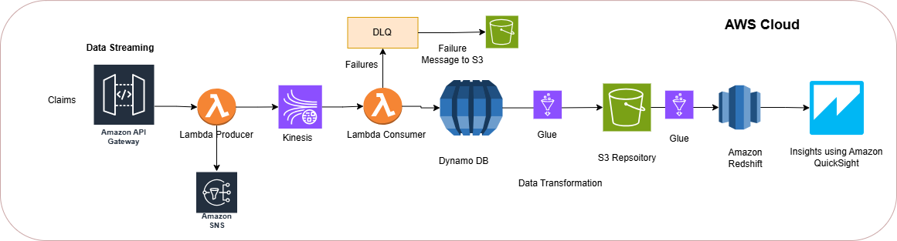
Data Flow

Slide 9
Services Used
Technology | Description
AWS Lambda & Glue functions | Glue is a Serverless compute and ETL services used to process, transform, and prepare data in a scalable, distributed environment. Lambda is used to run small piece of code.
Amazon Kinesis | Real-time data streaming service used to ingest and process streaming data using a producer–consumer architecture.
Dynamo DB | Fully managed NoSQL database service designed for high-performance, low-latency applications at any scale.
Amazon Quick Sights | Business intelligence service used for data visualization and dashboarding, integrated with Amazon Redshift and other data sources.
S3 Bucket | Scalable object storage service used to store raw, processed, and archived data (data lake storage layer)
Postgresql | Open-source relational database used for structured data storage, transactional workloads, and as a data source for analytics pipelines.
Amazon SNS | Fully managed messaging service used for pub/sub communication, event notifications, and triggering downstream processes.
Amazon Redshift | Fully managed, columnar data warehouse optimized for fast SQL queries and large-scale analytics.
Amazon Step Functions | Serverless workflow orchestration service used to coordinate and automate multi-step data processing pipelines.
Amazon API Gateway | Managed service for creating, publishing, and securing APIs to expose backend services and trigger workflows.
Amazon IAM | Service used to securely control access to AWS resources through users, roles, and permissions.

Slide 10
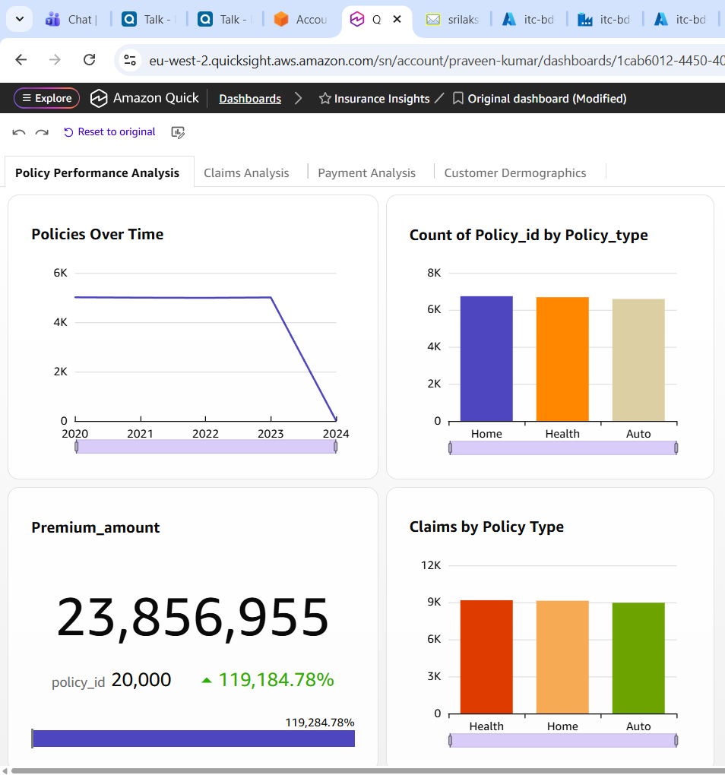
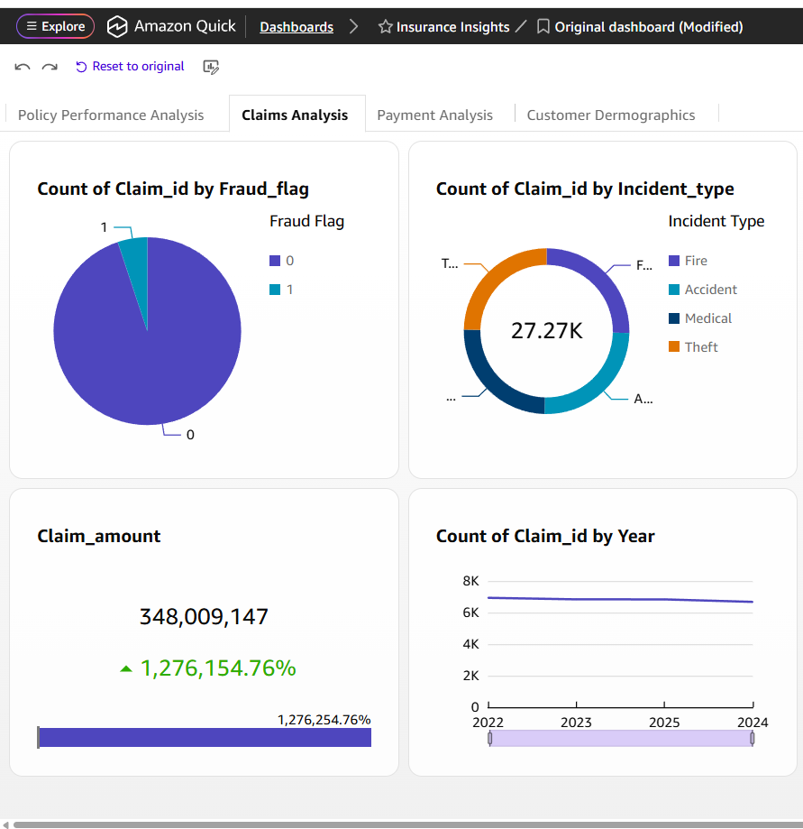
Insights

Slide 11
Challenges & Future Enhancements
Challenges
Future Enhancements
IAM Permissions across services.
Idempotency.
Watermark handling.
AWS console auto logout issue.
Following coding standards & optimize the code to improve the performance of the execution.
A big data solution leveraging different cloud technologies, using Azure.
Enhance the end to end pipeline using Amazon EMR.
CI/CD implementation.

Slide 12
Conclusion
Built end-to-end data pipeline (Bronze → Gold)
Integrated batch & streaming processing
Delivered actionable business insights

Slide 13
Questions?

